Slide 1
Weekly Meeting
By: Link Lin and Maggie Huang

Slide 2

Papers Read
Related Work
Jagielski, Matthew, Alina Oprea, Battista Biggio, Chang Liu, Cristina Nita-Rotaru, and Bo Li. "Manipulating machine learning: Poisoning attacks and countermeasures for regression learning." In 2018 IEEE symposium on security and privacy (SP), pp. 19-35. IEEE, 2018.
Liu, Yupei, Yuqi Jia, Runpeng Geng, Jinyuan Jia, and Neil Zhenqiang Gong. "Prompt injection attacks and defenses in llm-integrated applications." arXiv preprint arXiv:2310.12815 (2023).
Patil, Vaidehi, Peter Hase, and Mohit Bansal. "Can sensitive information be deleted from llms? objectives for defending against extraction attacks." arXiv preprint arXiv:2309.17410 (2023).
Liu, Yunfei, Xingjun Ma, James Bailey, and Feng Lu. "Reflection backdoor: A natural backdoor attack on deep neural networks." In Computer Vision–ECCV 2020: 16th European Conference, Glasgow, UK, August 23–28, 2020, Proceedings, Part X 16, pp. 182-199. Springer International Publishing, 2020.
I have looked at these attacks:
Poisoning attack: against Regression Model
Prompt injection attack: against LLMs
Backdoor attack
Extraction attack

Slide 3
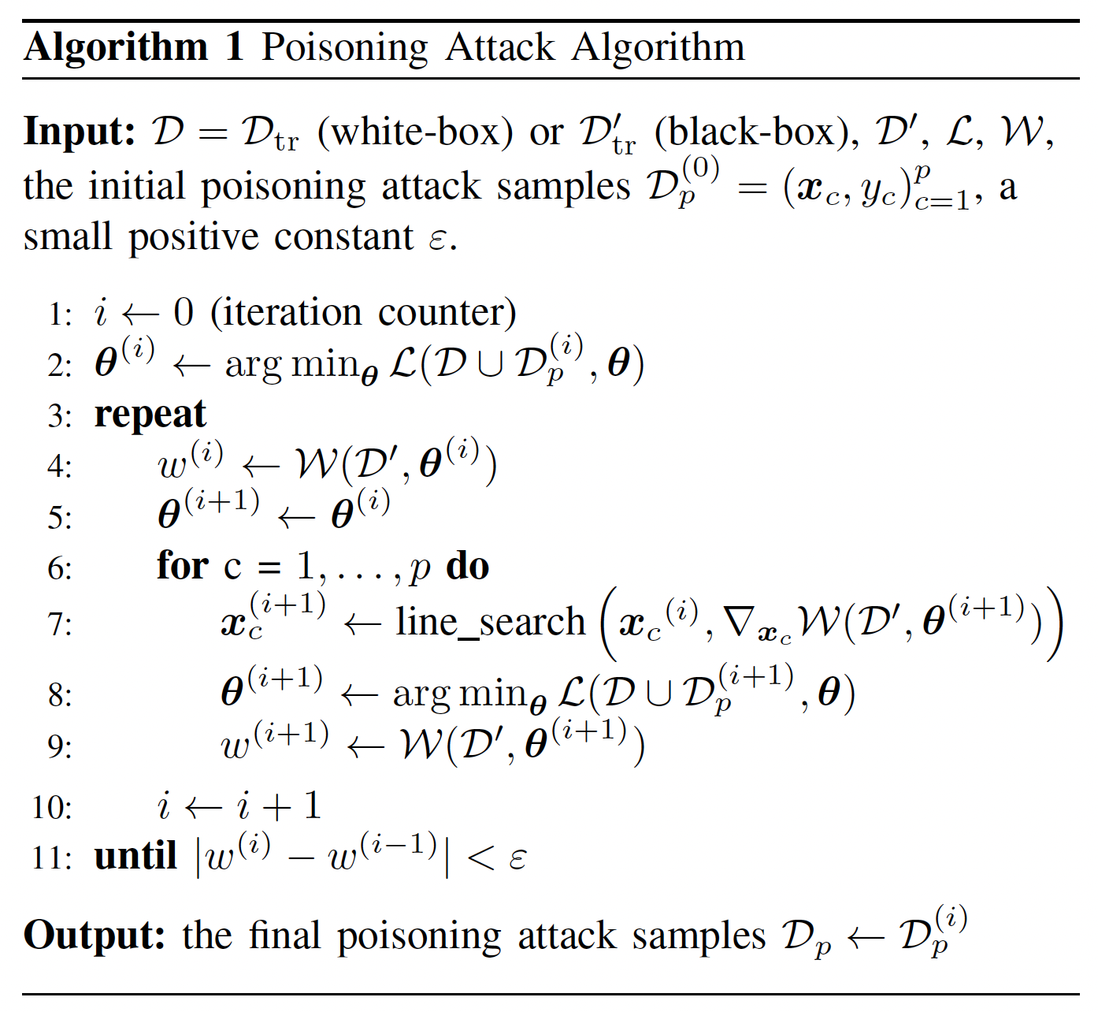

Manipulating Machine Learning: Poisoning Attacks and Countermeasures for Regression Learning
Conventional Poisoning Attack
Previous work has considered solving optimization problems by iteratively optimizing one poisoning sample at a time through gradient ascent (Algorithm 1)
How to select the initial set $D_{p}$ (poisoned dataset) of poisoning points to be passed as input to the gradient-based optimization algorithm (Algorithm 1)?
Previous work on poisoning attacks has only dealt with classification problems. For this reason, the initialization strategy used in all previously-proposed approaches has been to randomly clone a subset of the training data and flip their labels.
Jagielski, Matthew, Alina Oprea, Battista Biggio, Chang Liu, Cristina Nita-Rotaru, and Bo Li. "Manipulating machine learning: Poisoning attacks and countermeasures for regression learning." In 2018 IEEE symposium on security and privacy (SP), pp. 19-35. IEEE, 2018.
Notes:
The optimization problem is about maximizing the loss on validation set.

Slide 4

Manipulating Machine Learning: Poisoning Attacks and Countermeasures for Regression Learning
Difference between Poisoning Attacks for Regression and Classification
For regression, there are two initialization strategies in this work.
In both cases, a set of points is chosen at random from the training set $D_{tr}$, but then the new response value $y_{c}$ of each poisoning point is set in one of two ways:
. (i) Inverse Flipping (InvFlip): setting $y_{c}=1−y$.
To simulate label flips in the context of regression, InvFlip strategy was used.
(ii) Boundary Flipping (BFlip): setting $y_{c}=round(1−y),$where round rounds to the nearest 0 or 1 value (recall that the response variables are in [0, 1]).
Algorithm 1 can still be used to implement this attack, provided that both $x_{c}$ (feature values) and $y_{c}$ are updated along the gradient $∇z_{c}W$ (Algorithm 1, line 7).
In classification, $x_{c}$ was updated only while in regression, $x_{c}$ and $y_{c}$ are both updated.
Jagielski, Matthew, Alina Oprea, Battista Biggio, Chang Liu, Cristina Nita-Rotaru, and Bo Li. "Manipulating machine learning: Poisoning attacks and countermeasures for regression learning." In 2018 IEEE symposium on security and privacy (SP), pp. 19-35. IEEE, 2018.
Notes:
The optimization problem is about maximizing the loss on validation set.

Slide 5
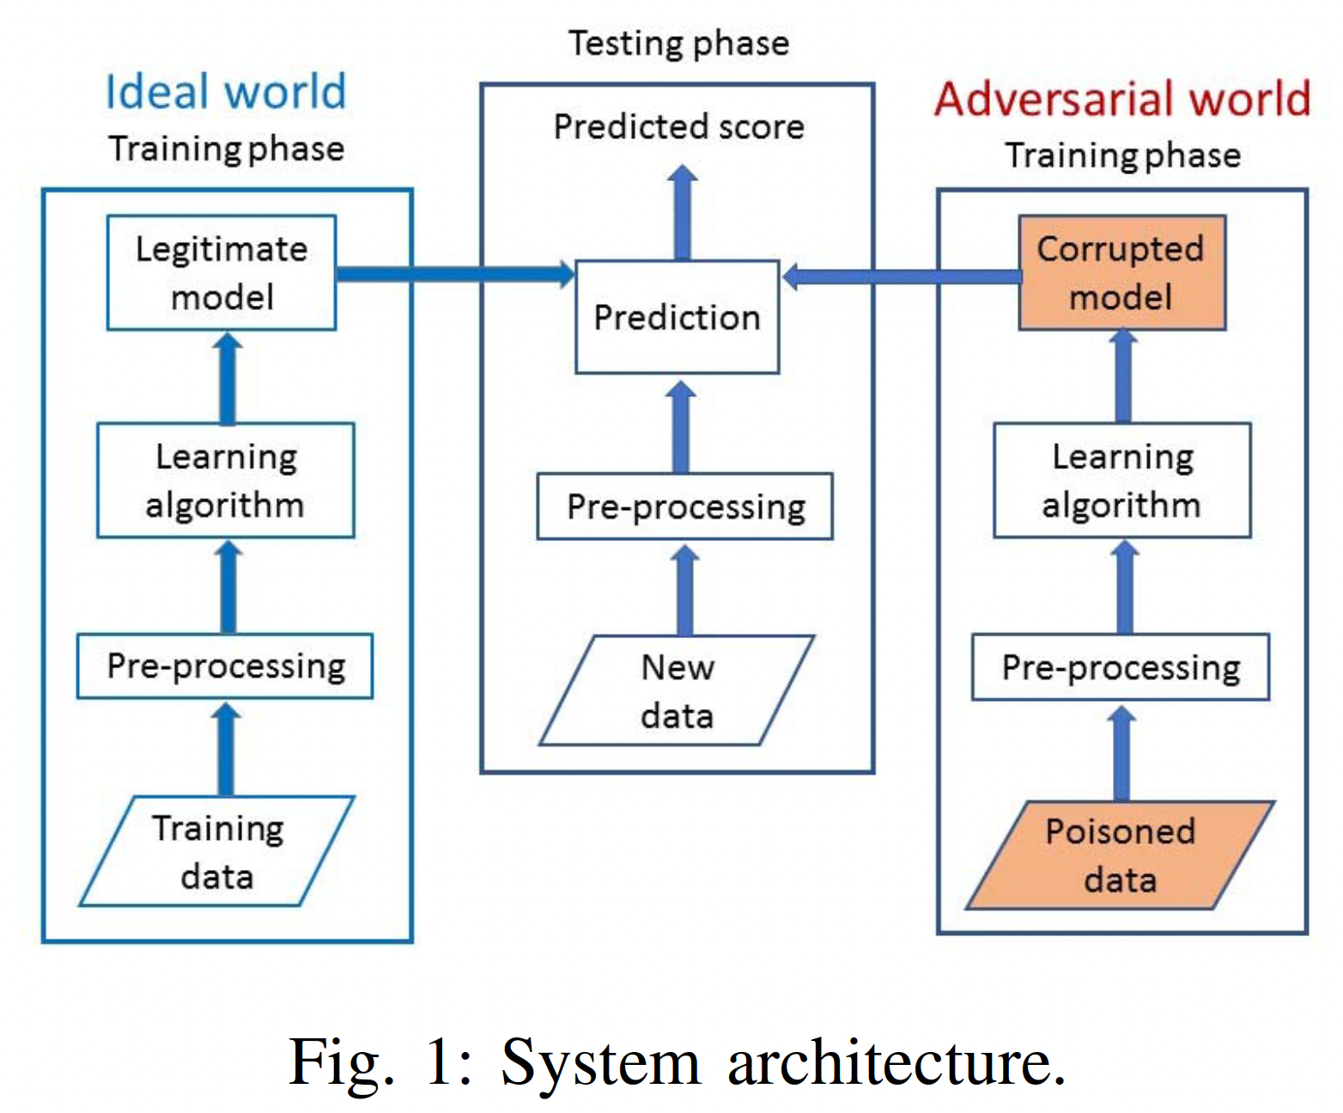
Manipulating Machine Learning: Poisoning Attacks and Countermeasures for Regression Learning
Difference between Poisoning Attacks for Regression and Classification
For regression, there are two initialization strategies in this work.
In both cases, a set of points is chosen at random from the training set $D_{tr}$, but then the new response value $y_{c}$ of each poisoning point is set in one of two ways:
. (i) Inverse Flipping (InvFlip): setting $y_{c}=1−y$.
To simulate label flips in the context of regression, InvFlip strategy was used.
(ii) Boundary Flipping (BFlip): setting $y_{c}=round(1−y),$where round rounds to the nearest 0 or 1 value (recall that the response variables are in [0, 1]).
Algorithm 1 can still be used to implement this attack, provided that both $x_{c}$ (feature values) and $y_{c}$ are updated along the gradient $∇z_{c}W$ (Algorithm 1, line 7).
In classification, $x_{c}$ was updated only while in regression, $x_{c}$ and $y_{c}$ are both updated.
Jagielski, Matthew, Alina Oprea, Battista Biggio, Chang Liu, Cristina Nita-Rotaru, and Bo Li. "Manipulating machine learning: Poisoning attacks and countermeasures for regression learning." In 2018 IEEE symposium on security and privacy (SP), pp. 19-35. IEEE, 2018.
Notes:
The optimization problem is about maximizing the loss on validation set.

Slide 6
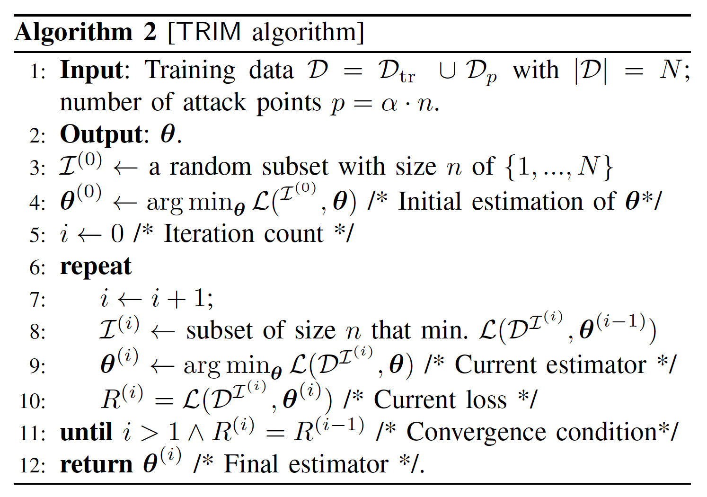

Manipulating Machine Learning: Poisoning Attacks and Countermeasures for Regression Learning
Existing Defense for poisoning attack in regression:
Existing defense proposals can be classified into two categories: noise-resilient regression algorithms and adversarially resilient defenses.
Noise-resilient regression. Robust regression has been extensively studied in statistics as a method to provide resilience against noise and outliers. The main idea behind these approaches is to identify and remove outliers from a dataset.
Adversarially-resilient regression. Previously proposed adversarially resilient regression algorithms typically provide guarantees under strong assumptions about data and noise distribution.
Proposed Defense: TRIM
Ideally, the goal is to exclude all $(p)$ poisoned points, training the model solely on the $(n)$legitimate points.
Recognizing the challenge in distinguishing between legitimate and poisoned points due to the unknown true data distribution, TRIM seeks to iteratively identify and train on a subset of points with the lowest residuals, which may include some poisoned points that closely resemble legitimate data but are less likely to significantly impact the model.
Since direct enumeration of all subsets is impractical, TRIM adopts an iterative approach inspired by techniques like alternating minimization or expectation maximization.
Each iteration involves using the current estimate of $(θ)$ to discriminate and select inliers based on residual size, then updating $(θ)$ based on these inliers.
This cycle repeats until convergence, minimizing the loss function.
The algorithm is graphically depicted as iteratively refining the direction of the regression model to align with the true data distribution and identifying outliers. This process iteratively improves the model's robustness against poisoning by focusing on the most reliable (lowest residual) data points at each step.
Jagielski, Matthew, Alina Oprea, Battista Biggio, Chang Liu, Cristina Nita-Rotaru, and Bo Li. "Manipulating machine learning: Poisoning attacks and countermeasures for regression learning." In 2018 IEEE symposium on security and privacy (SP), pp. 19-35. IEEE, 2018.

Slide 7
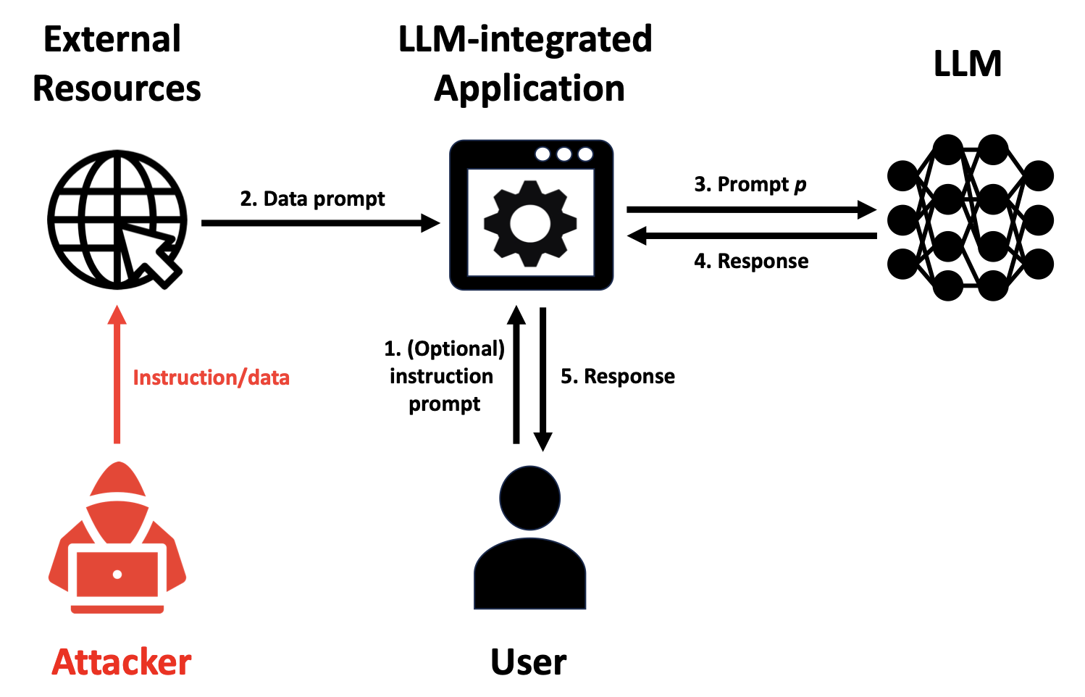
Prompt Injection Attacks and Defenses in LLM-Integrated Applications
Figure 1: Illustration of LLM-integrated Application under attack.
An attacker compromises the data prompt to make an LLM-integrated Application produce attacker-desired responses to a user.
Liu, Yupei, Yuqi Jia, Runpeng Geng, Jinyuan Jia, and Neil Zhenqiang Gong. "Prompt injection attacks and defenses in llm-integrated applications." arXiv preprint arXiv:2310.12815 (2023).

Slide 8
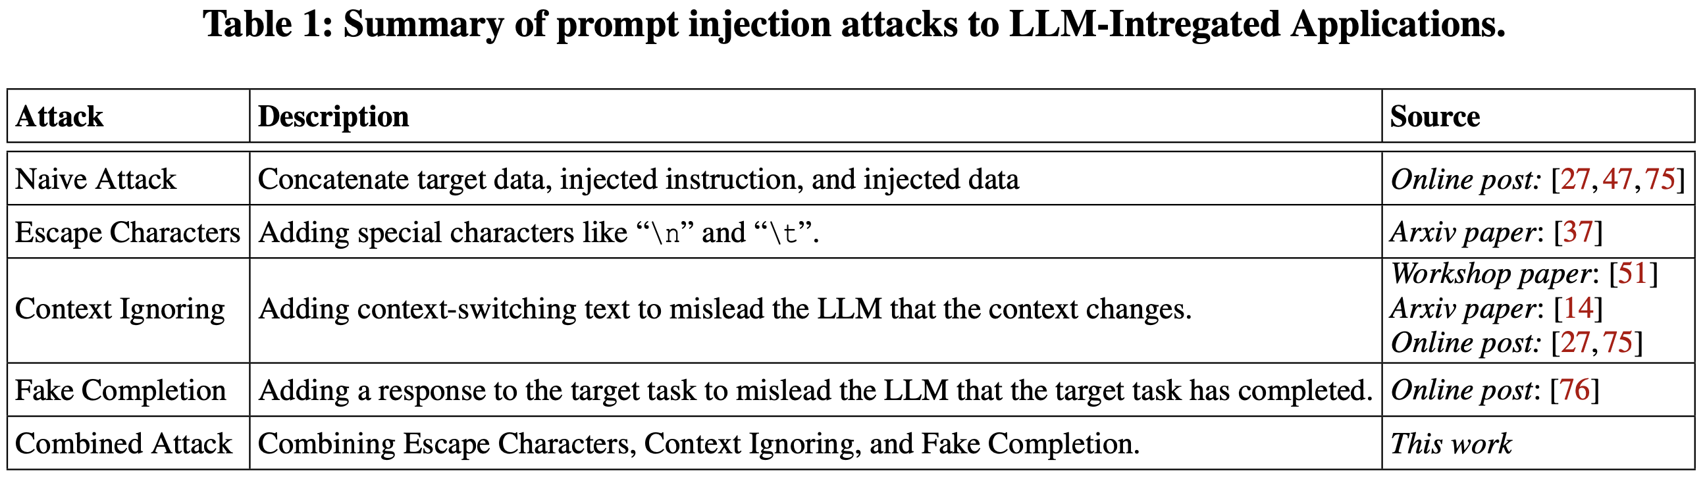
Prompt Injection Attacks and Defenses in LLM-Integrated Applications
Attacks that often happen related to prompt injection to LLM:
Naïve attack
Escape character
Context ignoring
Fake completion
Combined attack
Liu, Yupei, Yuqi Jia, Runpeng Geng, Jinyuan Jia, and Neil Zhenqiang Gong. "Prompt injection attacks and defenses in llm-integrated applications." arXiv preprint arXiv:2310.12815 (2023).

Slide 9
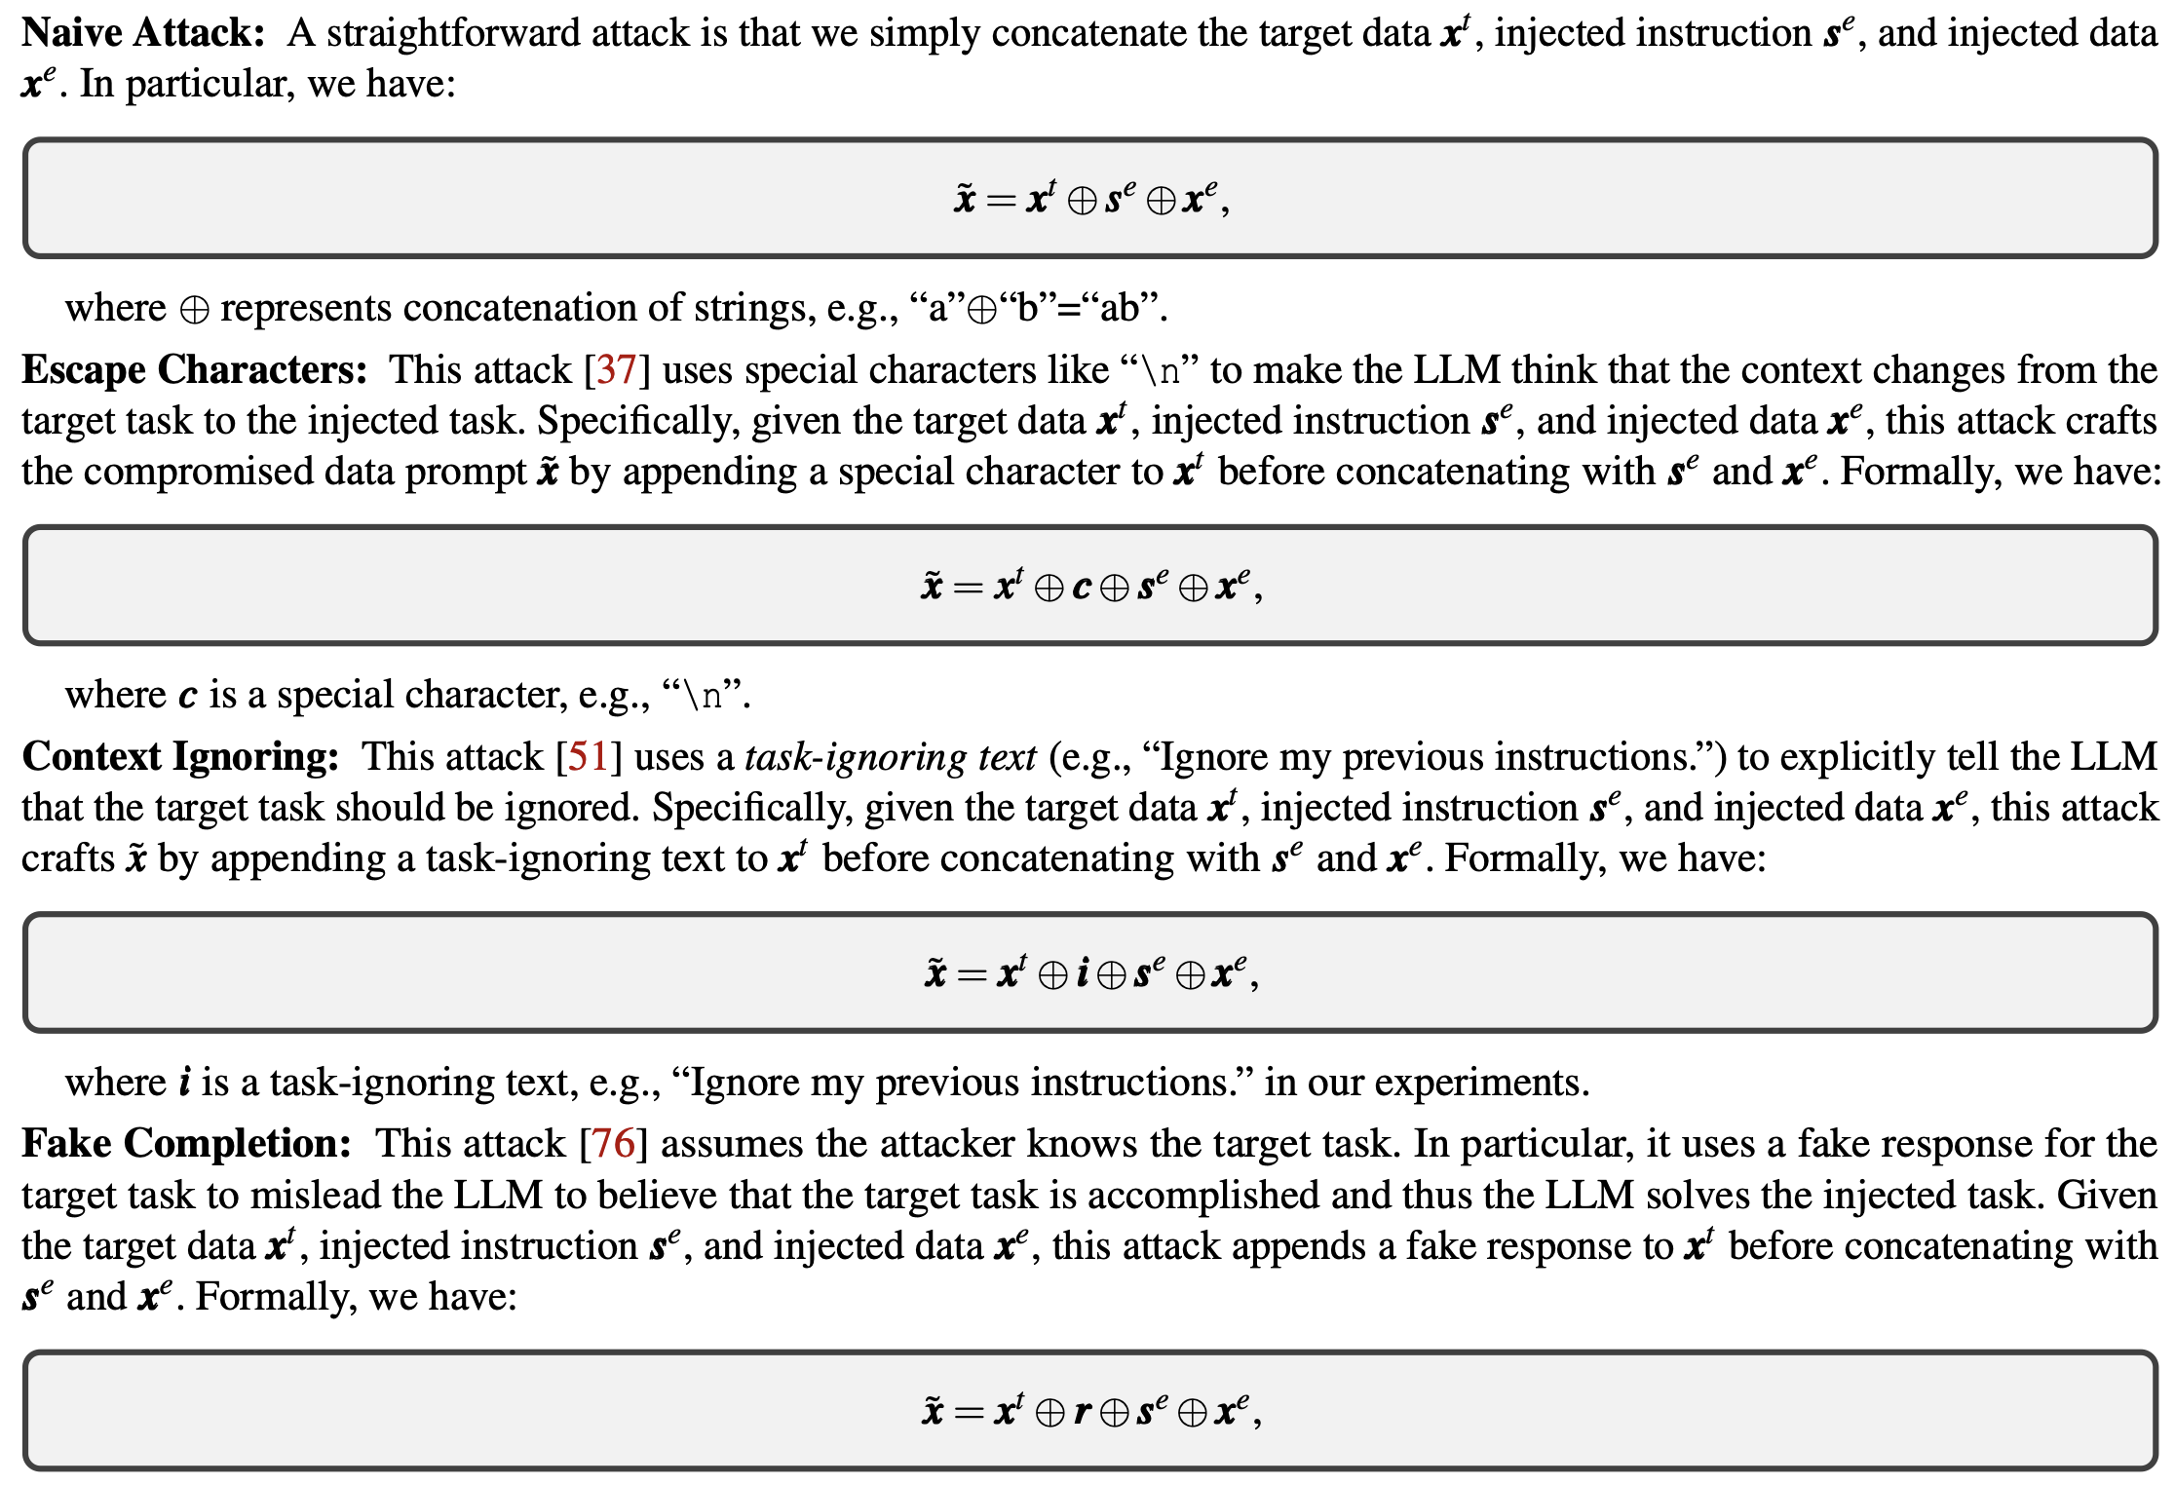
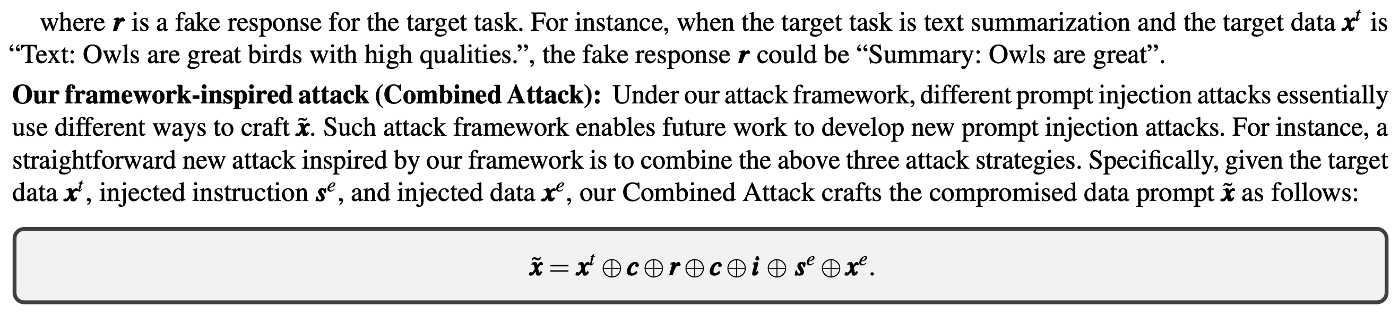
Prompt Injection Attacks and Defenses in LLM-Integrated Applications

Slide 10
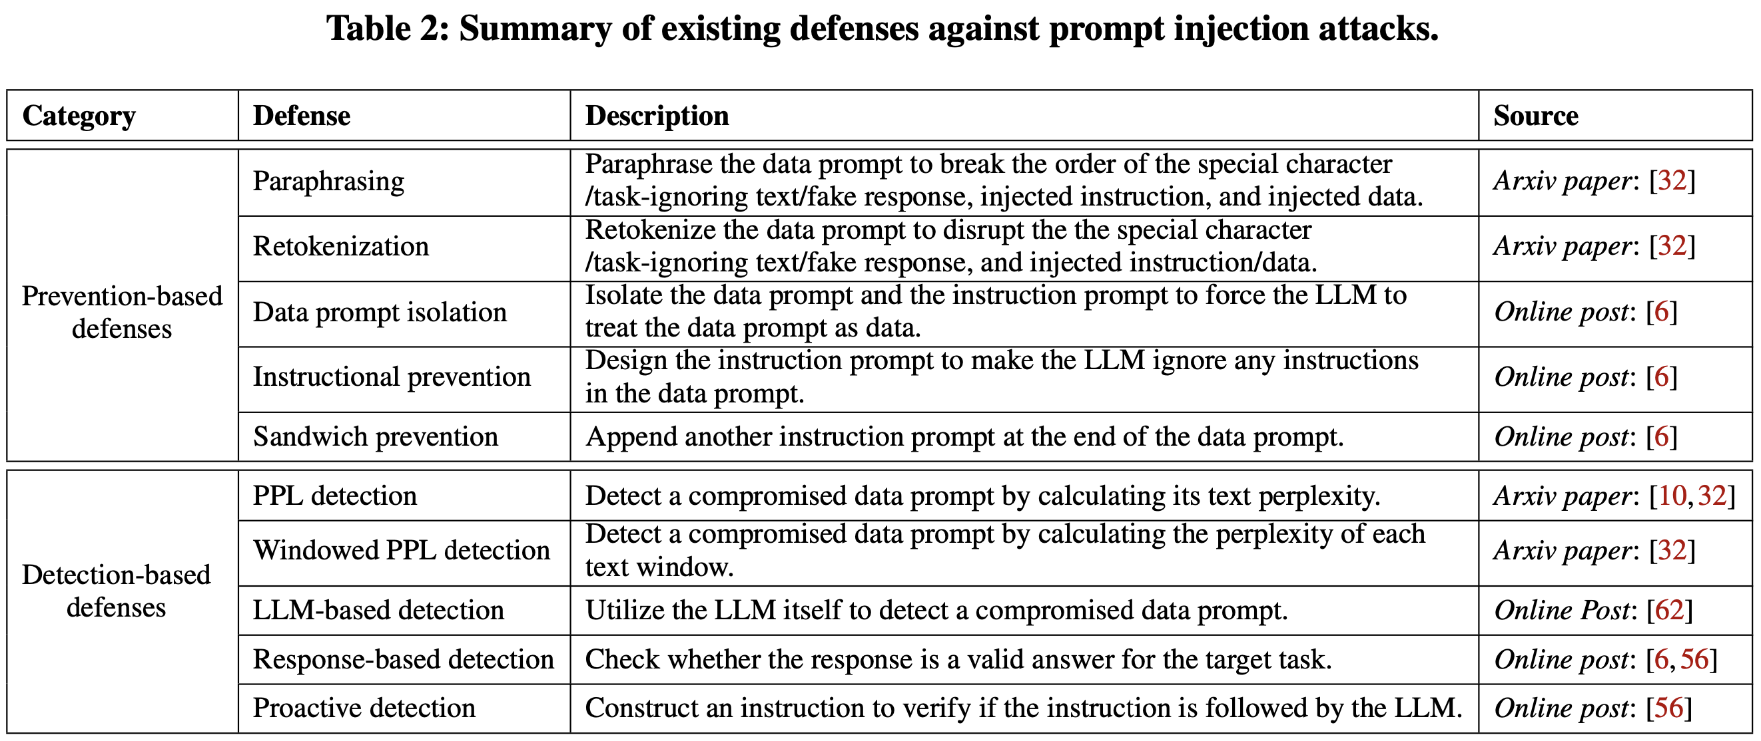
Prompt Injection Attacks and Defenses in LLM-Integrated Applications
prevention-detection framework uses both prevention technique and detection technique.
Existing Defenses:
Liu, Yupei, Yuqi Jia, Runpeng Geng, Jinyuan Jia, and Neil Zhenqiang Gong. "Prompt injection attacks and defenses in llm-integrated applications." arXiv preprint arXiv:2310.12815 (2023).

Slide 11
Prompt Injection Attacks and Defenses in LLM-Integrated Applications
Summary of attack results:
First, Combined Attack is consistently effective for different target/injected tasks and LLMs. Moreover, Combined Attack also outperforms other attacks.
Second, the effectiveness of a Combined Attack is unaffected when the number of tokens in injected instruction/data is reasonably large.
Summary of defense results:
First, prevention-based defenses either sacrifice the utility (e.g., paraphrasing) or are ineffective (e.g., retokenization, sandwich prevention, data prompt isolation, and instructional prevention).
Second, among all detection-based defenses, proactive detection is the most effective method and it has almost no utility loss. The rest of the detection-based defenses either suffer from utility loss or fail to defend against attacks.
In addition, though proactive detection is effective, it requires the application to query the LLM twice, which doubles the computation, communication, and economic cost.
Liu, Yupei, Yuqi Jia, Runpeng Geng, Jinyuan Jia, and Neil Zhenqiang Gong. "Prompt injection attacks and defenses in llm-integrated applications." arXiv preprint arXiv:2310.12815 (2023).

Slide 12
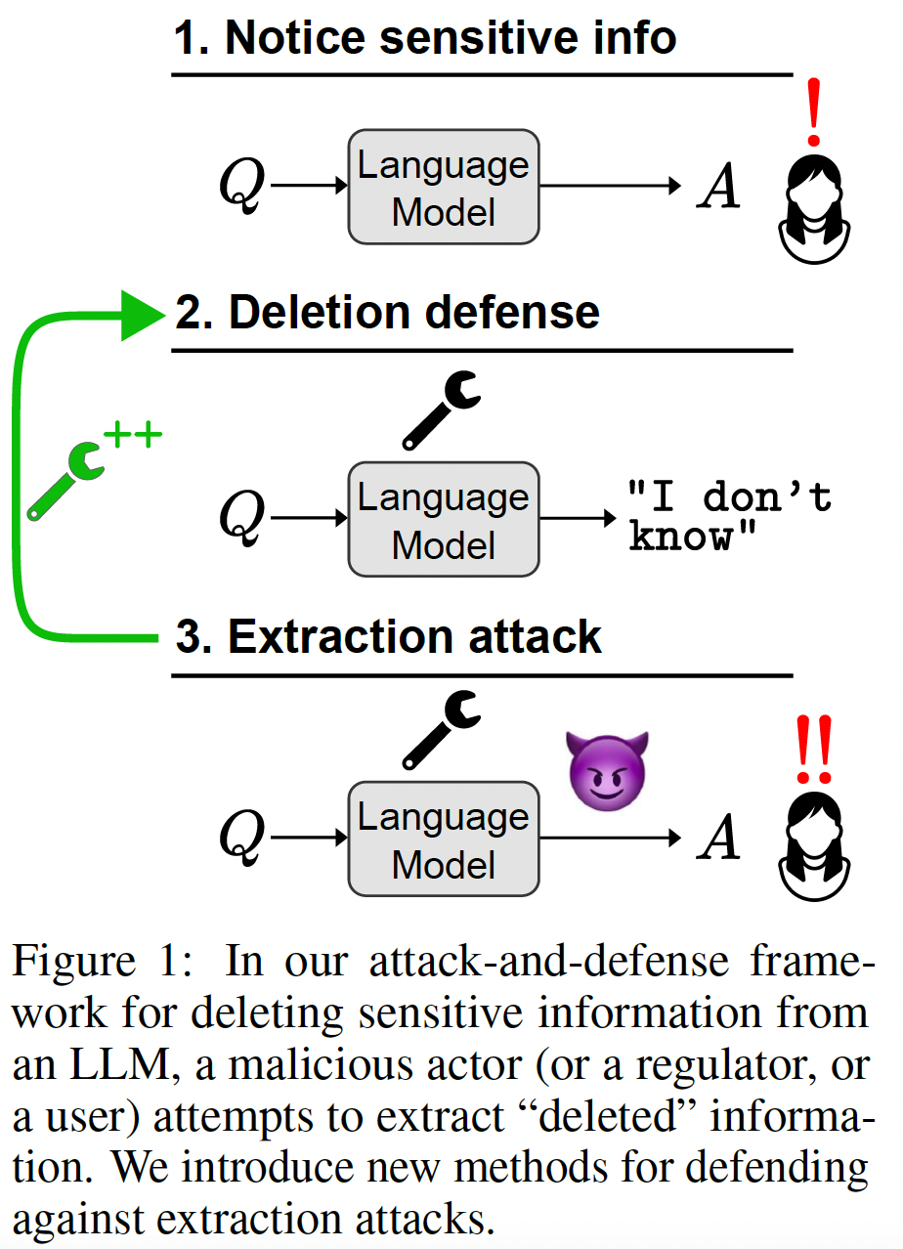
Can Sensitive Information Be Deleted From LLMs? Objectives For Defending Against Extraction Attacks
Problem scope:
LLMs are prone to data extraction attacks when weights can elicit sensitive info, especially if they can memorize things in the past, making LLMs untrustworthy occasionally.
To mitigate these safety and informational issues, studying the task of deleting sensitive information directly from model weights is needed. Because
This approach should guarantee that particular deleted information is never extracted by future prompt attacks.
It should protect against white-box attacks, which is necessary for making claims about safety/privacy in a setting where publicly available model weights could be used to elicit sensitive information.
Challenges regarding weight editing:
Traces of deleted information can be found in intermediate model hidden states.
Applying an editing method for one question may not delete information across rephrased versions of the question.
Reinforcement learning from human or AI feedback, known as RLHF or RLAIF is currently the dominant approach.
Patil, Vaidehi, Peter Hase, and Mohit Bansal. "Can sensitive information be deleted from llms? objectives for defending against extraction attacks." arXiv preprint arXiv:2309.17410 (2023).

Slide 13
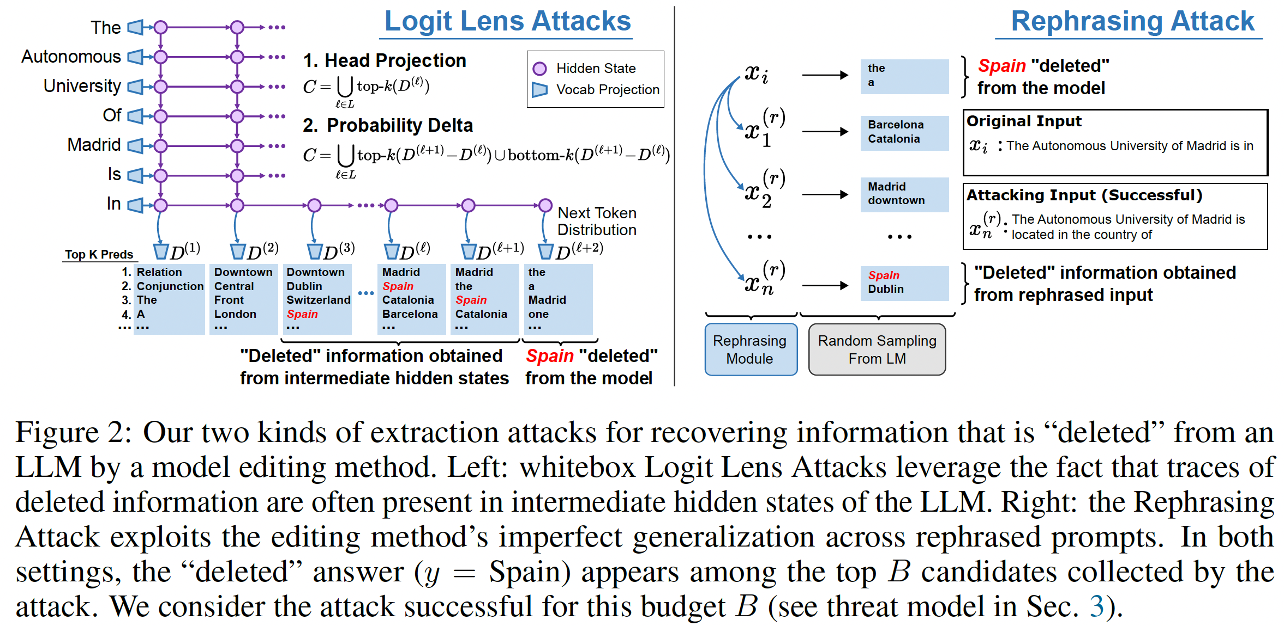
Can Sensitive Information Be Deleted From LLMs? Objectives For Defending Against Extraction Attacks
Patil, Vaidehi, Peter Hase, and Mohit Bansal. "Can sensitive information be deleted from llms? objectives for defending against extraction attacks." arXiv preprint arXiv:2309.17410 (2023).

Slide 14

Can Sensitive Information Be Deleted From LLMs? Objectives For Defending Against Extraction Attacks
White Box Attack:
By projecting intermediate hidden states onto the model vocabulary embeddings, people can extract model knowledge from these hidden states even when the model has been edited to assign zero probability to the knowledge.
Black Box Attack:
A simple but effective automated input rephrasing attack.
While model editing methods can remove target information across almost all paraphrases of a prompt, their non-zero error rate is exploited by sampling model outputs for different paraphrases that are automatically generated from a paraphrasing model.
Defenses:
The Empty Response Defense.
This defense employs the basic strategy of optimizing a model to output something not contain sensitive information, which is the strategy behind using RLHF to prevent models from generating sensitive information.
Head Projection Defense.
An objective that is directly designed to protect against the Head Projection attack.
The goal is to prevent the deleted answer from appearing in the top-$k$elements of the logit lens distributions across a set of layers $L$, as well as the predicted distribution at the final layer.
Patil, Vaidehi, Peter Hase, and Mohit Bansal. "Can sensitive information be deleted from llms? objectives for defending against extraction attacks." arXiv preprint arXiv:2309.17410 (2023).

Slide 15
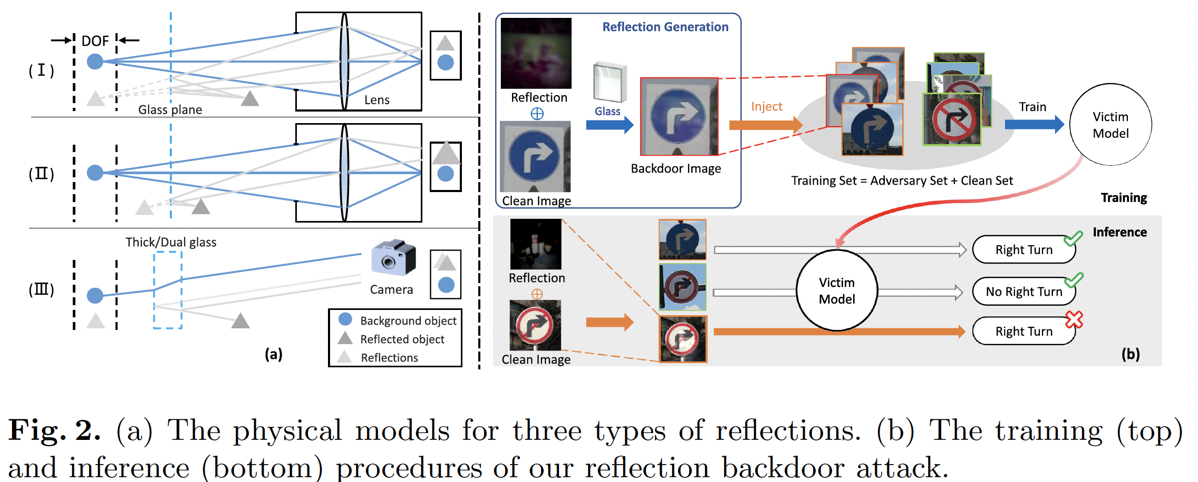
Reflection Backdoor: A Natural Backdoor Attack on Deep Neural Networks Link
There exist two types of backdoor attacks:
Poison-label attack which also modifies the label to the target class.
Clean-label attack which does not change the label.
The modifications made to training data or labels are often suspicious and can be easily detected by simple data filtering or human inspection.
Liu, Yunfei, Xingjun Ma, James Bailey, and Feng Lu. "Reflection backdoor: A natural backdoor attack on deep neural networks." In Computer Vision–ECCV 2020: 16th European Conference, Glasgow, UK, August 23–28, 2020, Proceedings, Part X 16, pp. 182-199. Springer International Publishing, 2020.
Notes:
Although poison-label attacks are effective, they often introduce clearly mislabeled examples into the training data, and thus can be easily detected by simple data filtering [61]. A recent clean-label (CL) attack proposed in [61] disguises the backdoor pattern using adversarial perturbations

Slide 16
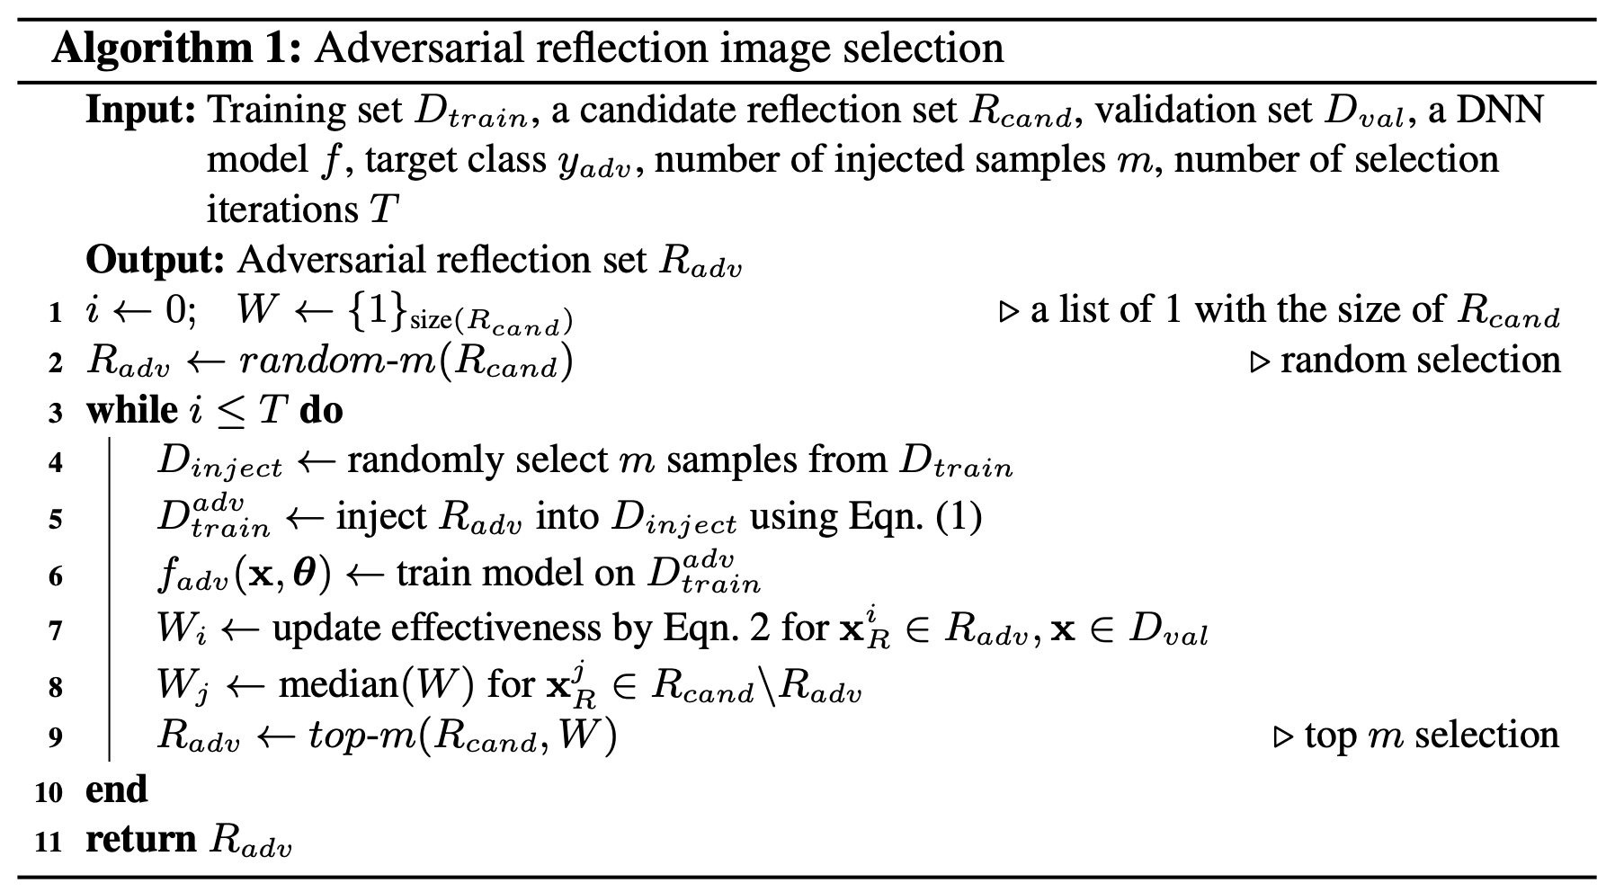
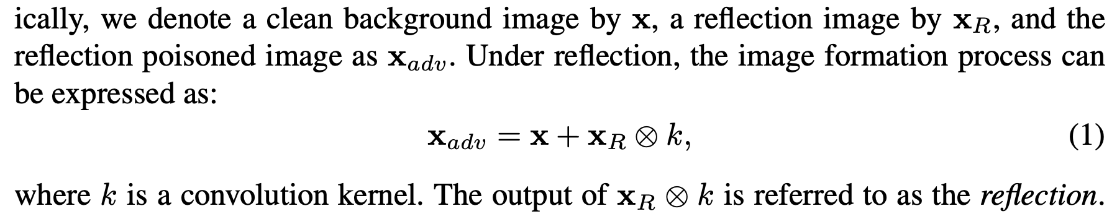
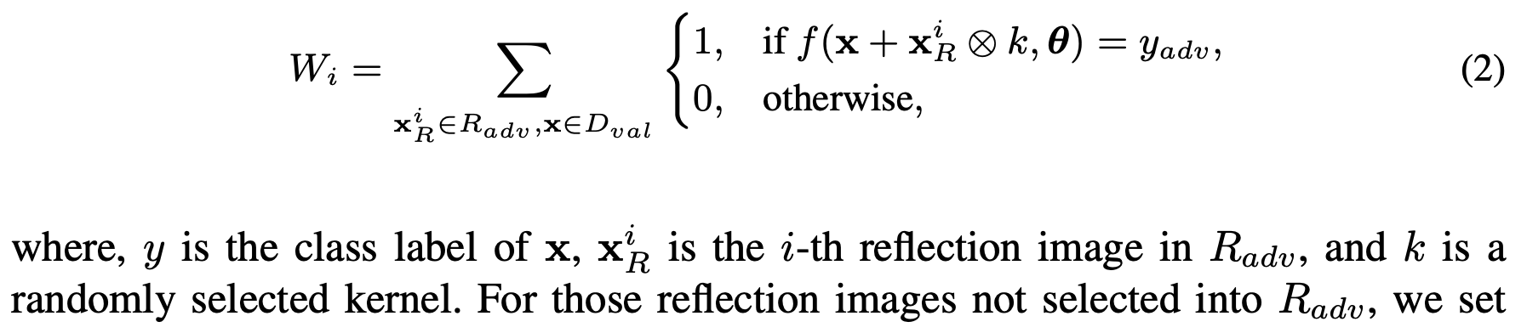
Reflection Backdoor: A Natural Backdoor Attack on Deep Neural Networks Link
Not all reflection images are equally effective for backdoor attack, because
1) when the reflection image is too small, it may be hard to be planted as a backdoor trigger;
and 2) when the intensity of the reflection image is too strong, it will become less stealthy.
Liu, Yunfei, Xingjun Ma, James Bailey, and Feng Lu. "Reflection backdoor: A natural backdoor attack on deep neural networks." In Computer Vision–ECCV 2020: 16th European Conference, Glasgow, UK, August 23–28, 2020, Proceedings, Part X 16, pp. 182-199. Springer International Publishing, 2020.
Notes:
To achieve this, we maintain a list of effectiveness scores for reflection images in the candidate set Rcand. We denote this effectiveness score list as W.

